Slide 1
The New Modern Application Platform Session 4: Kubernetes Intro
“Bridging the growing chasm between developers and infra engineering”
Ellis Paul
Senior TAM
March 2021

Slide 2
Today’s Class
Architecture and comparison to vSphere
How K8s containers are different from VMs for an operator
Kubernetes installation and using “kind”
kubectl and kube config
A word on versions and apiversion
Intro to yaml
Pods, replicasets, and deployments
Debugging and logs
Intro to networking

Slide 3
Kubernetes Architecture
Why not just use Docker servers to run my containers?
What happens if a running container has a problem/dies?
How to expose containers sitting within a host to external/Ingress traffic?
How to determine AND scale 'n' no. of containers when application workloads increase?
How to isolate two containers sitting on the same host such that they do not talk to each other?
How to migrate Containers from one host to another for host maintenance?

Slide 4
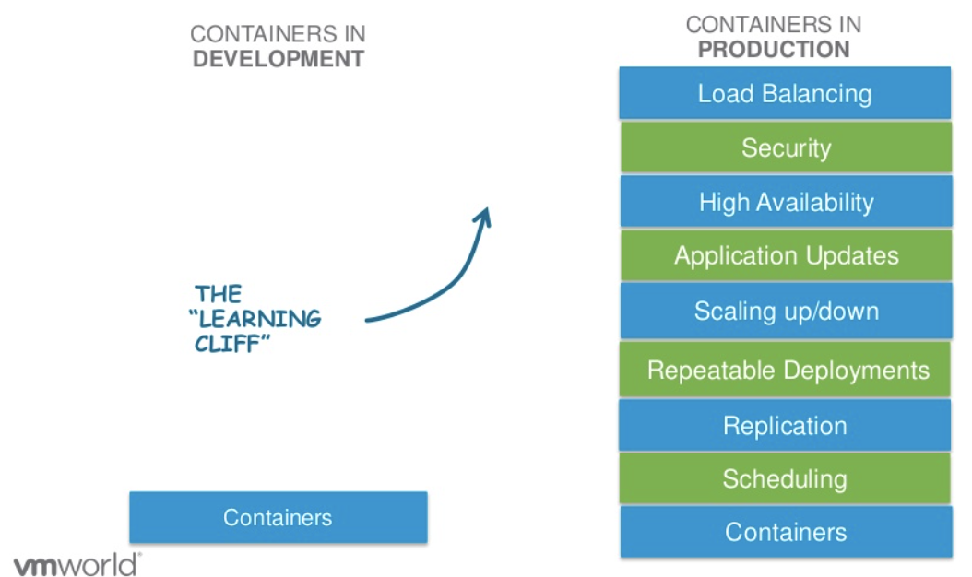











Kubernetes Architecture
Challenges with Containers

Slide 5
Kubernetes Architecture
https://blogs.vmware.com/cloudnative/2017/10/25/kubernetes-introduction-vmware-users/
Let’s start by reminding ourselves what a microservice is:
12 Factor
Would we patch a container?
Would we backup the platform?
Review Architecture
Control Plane vs worker nodes
https://kubernetes.io/docs/concepts/overview/components/
Compare to VMware
CNI and CSI not specified
In vSphere, the base resource “node” is an ESXi Host
In K8s, the base resource “node” is a VM (usually, can be HW)

Slide 6
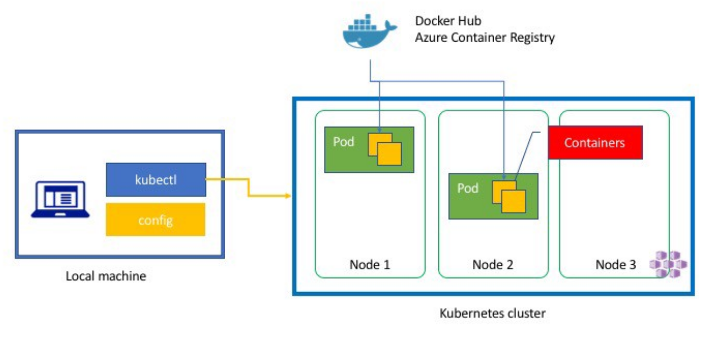
Kubernetes Architecture #1
Container Deployment

Slide 7
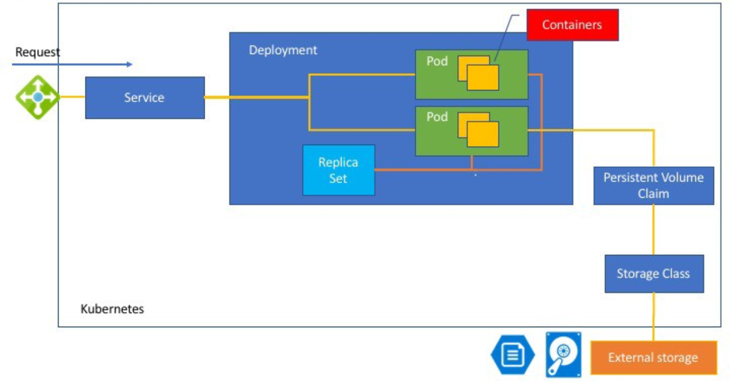
Kubernetes Architecture #2
Container Objects

Slide 8
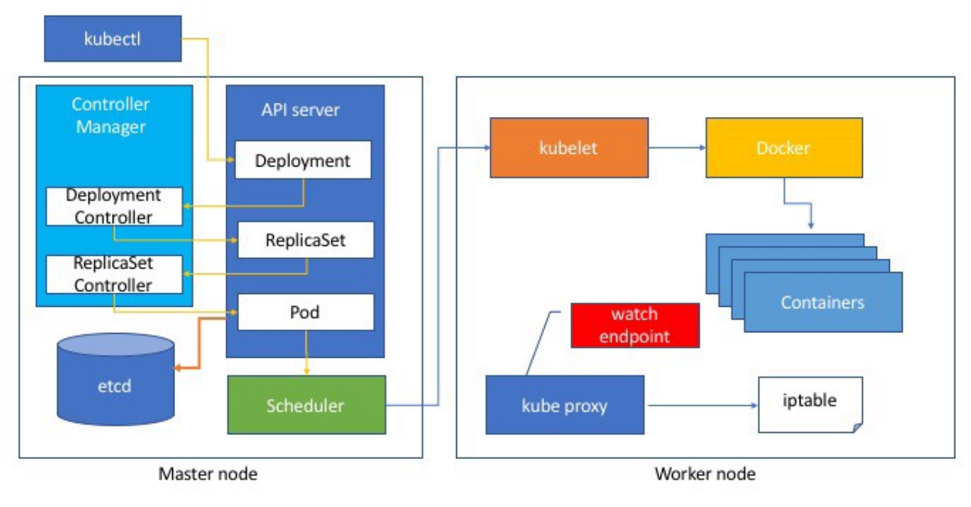
Kubernetes Architecture #3
Overall Architecture

Slide 9
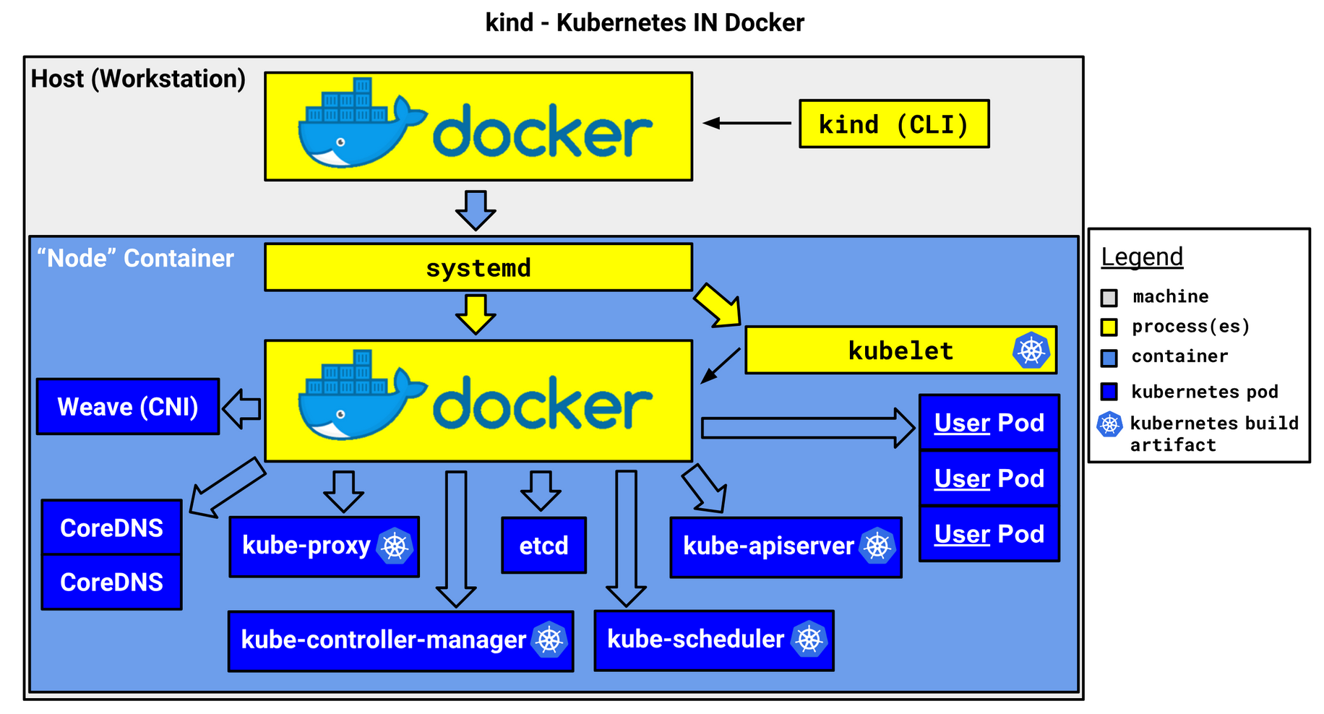
Running Kubernetes on your laptop
Use kind to quickly spin up a K8s cluster
Kind requires Docker and kubectl
https://kubernetes.io/docs/tasks/tools/install-kubectl/
Install Kind: https://kind.sigs.k8s.io/docs/user/quick-start/

Slide 10
kubectl and kube config
Switching context
The default config file is located at: $home/.kube/config
Install kubectl: https://kubernetes.io/docs/tasks/tools/install-kubectl/
Create cluster with kind:
kind create cluster --name tamlab --config kind-config.yaml
kind get clusters
Switch contexts
kubectl config get-contexts
kubectl config current-context
kubectl config set-context kind-tamlab
kubectl --context kind-tamlab get namespace

Slide 11
Intro to yaml code
yaml lists:
args:
- sleep
- "1000”
spec:
containers:
- name: front-end
image: nginx
ports:
- containerPort: 80
- name: rss-reader
image: nickchase/rss-php-nginx:v1
ports:
- containerPort: 88
Yet another markup language
yaml is a superset of json
Spacing matters! Use an editor like ATOM or VS Code.
yaml maps:
---
apiVersion: v1
kind: Pod
metadata:
name: rss-site
labels:
app: web
Key
Value

Slide 12
Namespaces
https://kubernetes.io/docs/concepts/overview/working-with-objects/namespaces/
Get all namespaces
kubectl get ns
kubectl -n kube-system get pods
kubectl get pods --all-namespaces
kubectl create ns demo
Namespaces can be used to implement Network Policy – strict traffic flow control: https://kubernetes.io/docs/concepts/services-networking/network-policies/
Resource Quotas: https://kubernetes.io/docs/concepts/policy/resource-quotas/
default is “default” ns if you don’t specify “-n” flag

Slide 13
Namespaces - continued
Separate your workloads
Namespaces are used in DNS FQDN:
{servicename}.{namespace}.svc.{cluster-domain}
i.e. invoice.default.svc.cluster.local
https://kubernetes.io/docs/concepts/services-networking/dns-pod-service/
Within a namespace, can use the shortname to resolve:
i.e. “ping invoice”
Outside a namespace, must use FQDN to resolve:
i.e. “ping invoice.default.svc.cluster.local” OR
“ping invoice.default”

Slide 14


The Movement from Containers to Pods
The Kubernetes “Pod”
A pod (as in a pod of whales) is a group of one or more containers
The Concept of a “Side Car”
Differentiated v Non-Differentiated Code
Containers within a pod share an IP address and port
Containers in a Pod also share the same data volumes
Pods are considered to be ephemeral / short-lived
Container 1
Container 2
Tools, Libs, SW
Tools, Libs, SW
172.16.4.2
VM
network

Slide 15
How Do I Run a Pod?
$ cat mywebserver.yaml
apiVersion: v1
kind: Pod
metadata:
name: my-webserver
labels:
app: web
spec:
containers:
- name: nginx
image: nginx:1.7.9
- name: wavefront
image: telegraf:1.9
$ kubectl –n demo apply -f mywebserver.yaml
pod "my-webserver" created
$ kubectl –n demo get pod
NAME READY STATUS RESTARTS AGE
my-webserver 0/1 Pending 0 15s
Container 1
Container 2
Tools, Libs, SW
Tools, Libs, SW
VM

Slide 16
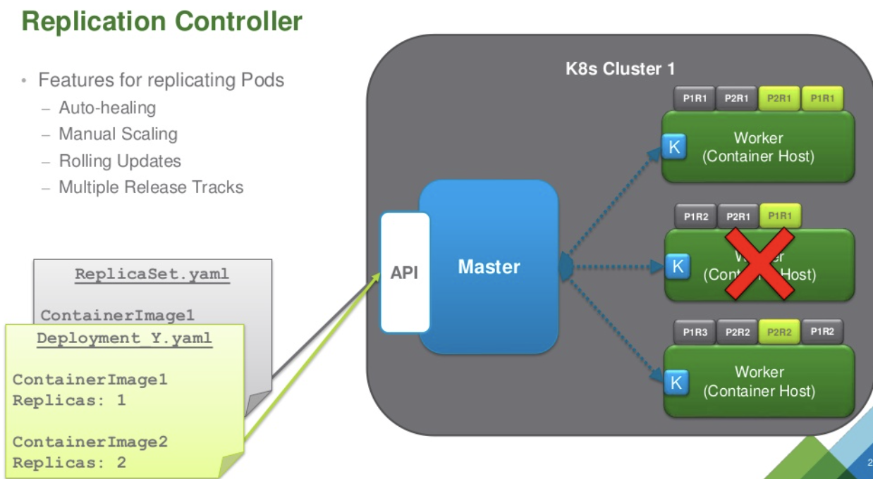
Replication Controller
Used by Deployments and Statefulsets

Slide 17
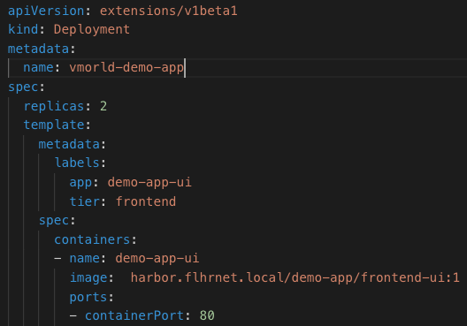


Deployments
Manage the Rollout of Apps
harbor.flhrnet.local
Frontend-ui :1
Kubelet
Running Pod
Running Pod
API
Kubernetes Control Plane
(API Server & and etcd nodes)
Tools, Libs, SW
Tools, Libs, SW
app: demo-app-ui
tier: frontend
app: demo-app-ui
tier: frontend
VM
VM

Slide 18
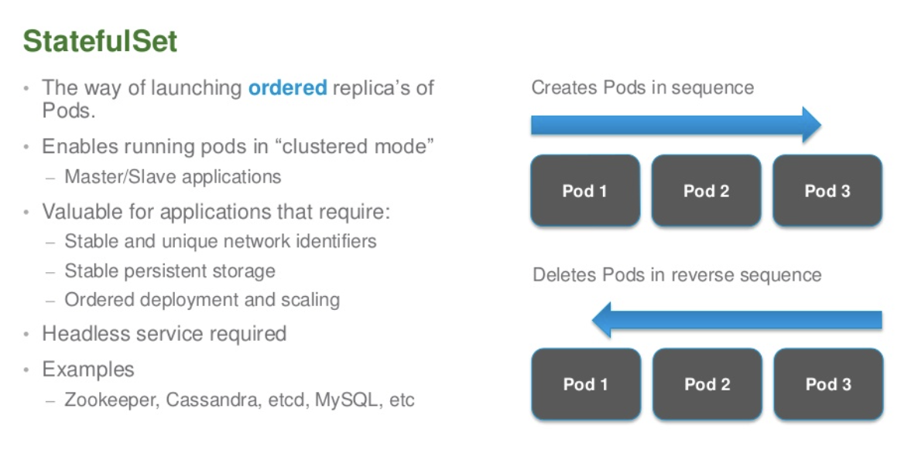
StatefulSet
Use this for applications with persistent storage and multiple members – i.e MongoDB

Slide 19
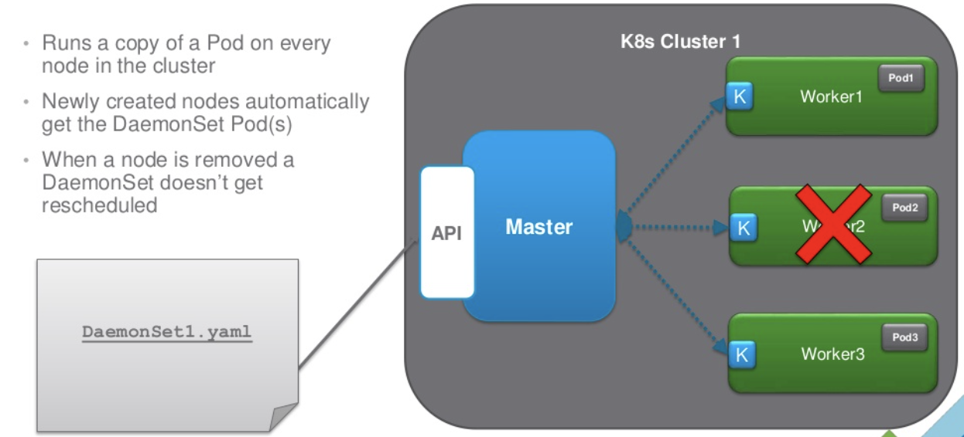
DaemonSet
Use this for when you need to run a pod on each K8s node – i.e fluentd log scraper

Slide 20
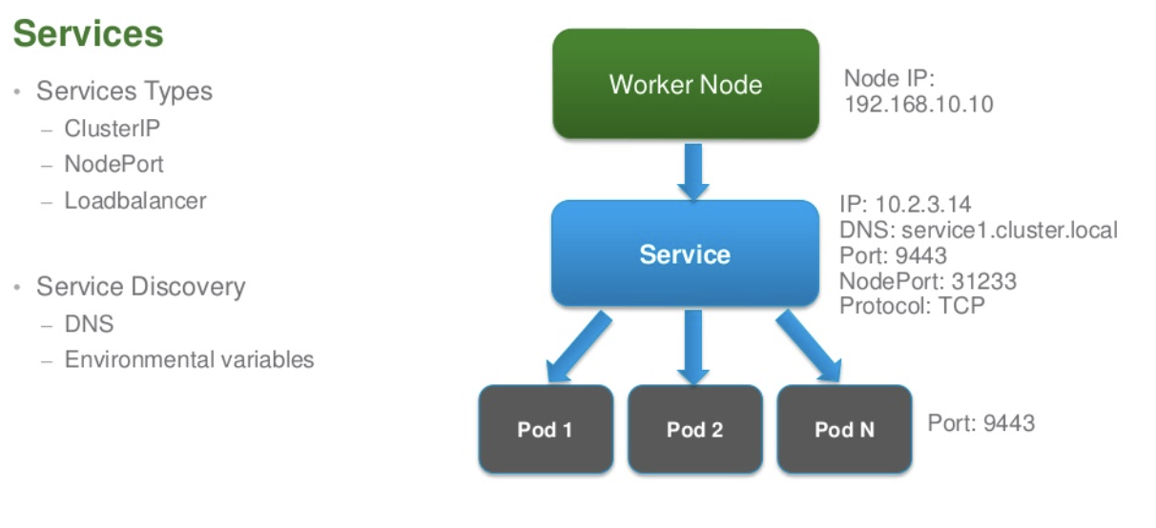
Intro to Networking
Services expose and load balance your application pods

Slide 21
Debugging and Logs
What is going on?
What “kinds” are available?
kubectl api-resources and kubectl api-versions
Describe the item
kubectl –n demo describe pod my-webserver
Show the logs
kubectl -n demo logs my-webserver nginx
Port forward the application’s port
kubectl -n demo port-forward my-webserver 8080:80
http://localhost:8080

Slide 22
Debugging and Logs #2
What is going on?
Jump into the container
kubectl -n demo exec -it my-webserver -c nginx -- /bin/bash
Deploy a ubuntu pod for network and curl tests
kubectl run my-shell -i --tty --image ubuntu -- /bin/bash
apt update, apt install curl, apt install dnsutils, apt install iputils-ping
Connect to service
Reconnect to my-shell: kubectl exec -it my-shell -- /bin/bash
ping rss-site.demo.svc.cluster.local

Slide 23
Lab Homework
For the next 2 weeks
Watch Michael Gasch’s VMWorld presentation: https://www.vmworld.com/en/video-library/video-landing.html?sessionid=15614127484680019FXJ&region=EU
Use kind to create a cluster
Clone class repo locally
Review how to check/set kubectl config
Deploy and describe a pod
Deploy and describe a deployment
Debugging
Create a service and access it from ubuntu pod

